Slide 1
Drag N’ Bag
Producer – Devin Carlson
Programmers – Gryphon McLaughlin, Tyler Dean
Artists – Devin Carlson, James Cooper Nowers, Mason Colbert
Sound Designer – Joseph Jaeger

Slide 2
High Concept
Card game where you play as a grocery clerk sorting food cards into temperature-based bags in order to keep customers happy

Slide 3
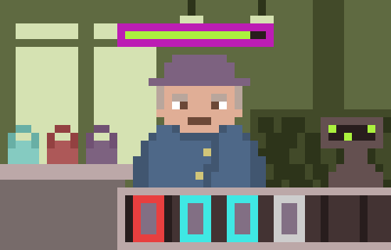
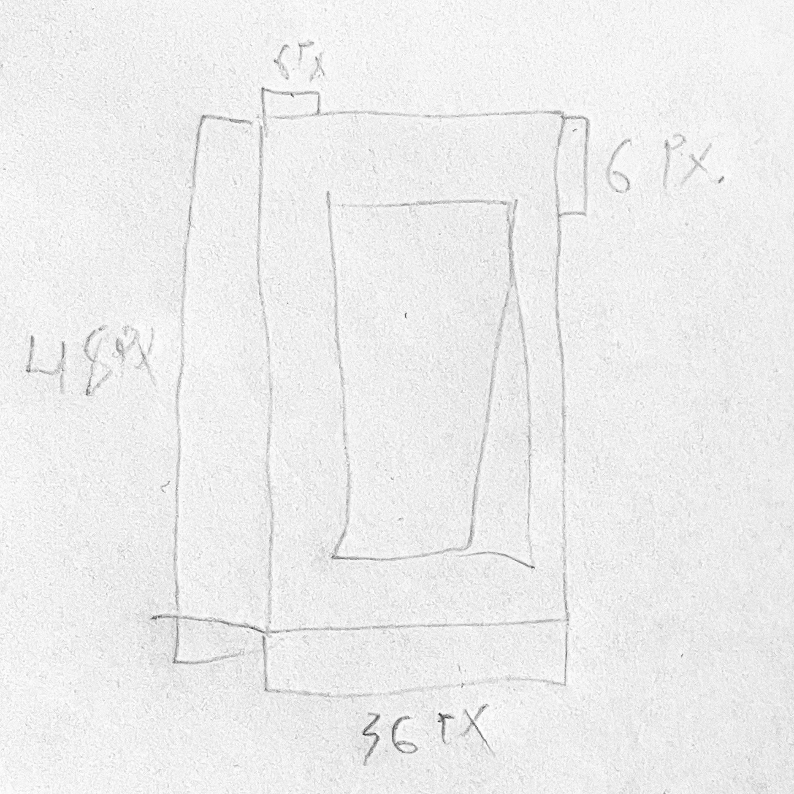
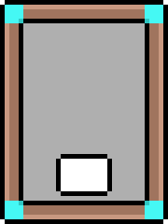
Early Ideations
Cards had same general format
Card types were shown by colored corners
Game screenshot mockup

Slide 4
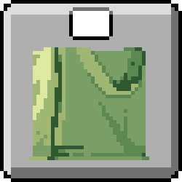
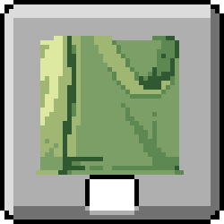

Development
NPC torsos
Card formatting

Slide 5
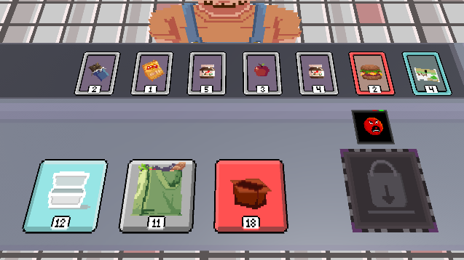
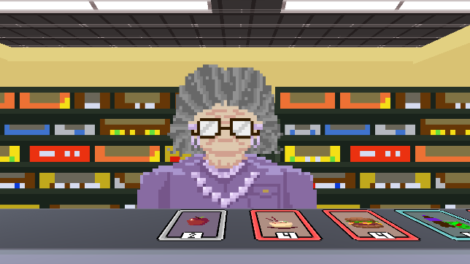
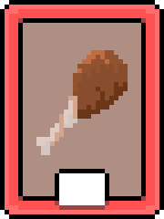


Finalized Assets
Food and Bag Cards
NPCs
Final Game Screenshots

Slide 6
Initial Sound Design Ideas
The initial idea for the music was to have something that was upbeat along with an intense quality added to it.
The music as well containing a drum beat or ideas from Samba music, 8bit sounds, and music you would hear at a grocery store.
And the Sound Effects having an 8bit and cartoonish quality to them.

Slide 7
Sounds and Music Finalized
The music ended up retaining most ideas, such a quality of Samba music, 8bit style sounds, and what it didn’t keep was the intensiveness. But that did leave the music resulting in more of a chill sound and yet having a fast pace.
And the sound effects didn’t end up as the initial idea stated, but they still did retain some 8 bit qualities in sound but developed into more of realistic sounds instead. Though they did end up still fitting for the game.

Slide 8
How Sounds Were Made
Used synths in a music software called Reaper to make some of the sounds, but for many of them I used sounds from a recording session in a studio in DigiPen. Other sounds where made from sounds that came from BBC Sound Effect Libraries.
Some sounds where layered with Recorded sound effects and sounds created by synths.
The Dialogue got made in an isolation booth (meaning a room that’s been treated to be very quiet), we had people from our group get recorded and as well as me for the different characters.

Slide 9
Highlighted Sounds and Music
Some of my favorite sounds from the game:
The Bag Deposit Sounds: When you put bags in the deposit
Clock In Sound: When you start the game
Character Dialogue
-Finally For music would be
Manager Type Beat: Plays in Secret room

Slide 10
Sound Credits
BBC Sound Effects
DigiPen Studio Recordings
Ethan shuffling cards

